Slide 1


Open Source Intelligence
Joe McDonnell
®
FEBRUARY 2026

Slide 2


Slide 3




DMUHACKERS
D0nt d0 1ll3gal sh1t
pls.

Slide 4






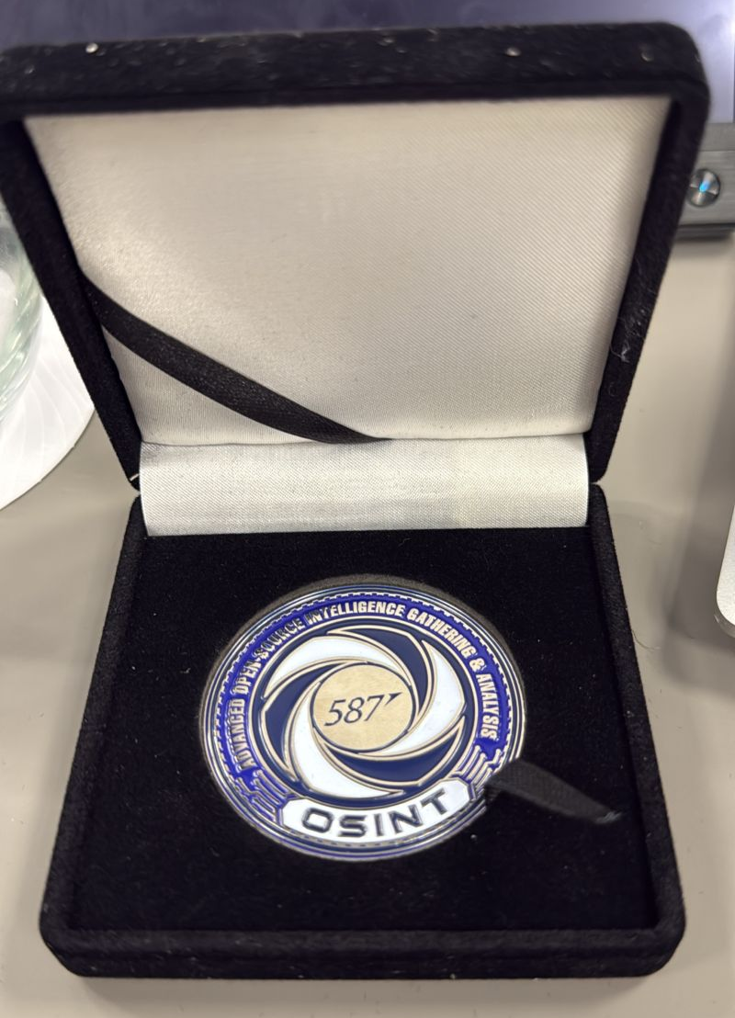

Who.IS me
Ex DMU Cyber Security Student [2018-2022]
DMU Hackers Social Sec 2019-2020 & Secretary 2021-2022
Boeing Defence UK - Cyber Security/SOC Intern (Placement Year)
Accenture Cheltenham - Senior SOC Analyst (Critical National Infrastructure)
Accenture Cheltenham - Lead SOC Analyst (Client Lead - Mutual Insurance/Investments)
North Quay Holdings - Senior OSINT Analyst
North Quay Holdings - Lead OSINT Analyst
®

Slide 5






Who.IS
Open-Source Intelligence heavy, All-Source Intelligence capable
Attack Surface Mapping & Reduction
Fugitive Relocation
Executive Protection / UHNWI &FO Risk Intelligence
Anti-poaching Operations
Breach & Stealer Notification & Analysis
Corporate Intelligence
®
Notes:
Icons are a bit on the distracting side being in-line with text. Might look neater if aligned on the right (i.e. icons going directly down from the ‘eye of sauron’ logo, still in line with text). Improves readability

Slide 6
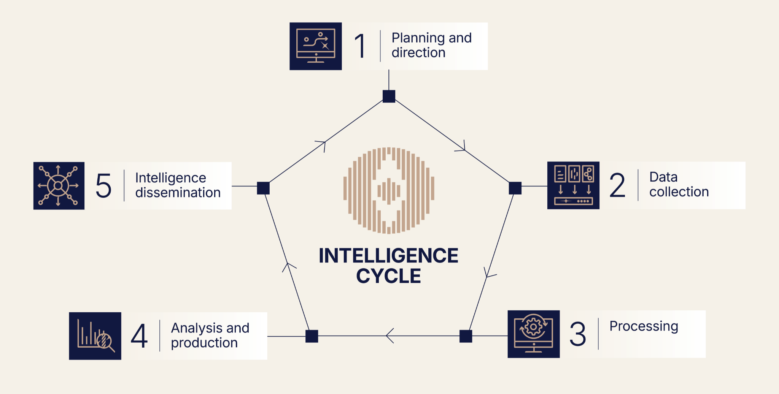

Slide 7
What is OSINT?
OSINT is the practice of turning public data into actionable intelligence.
No privileged access
No exploits
No target interaction
®
Notes:
Bolded text is tiny!

Slide 8
What counts as OSINT?
Open sources include:
Web + news + corporate records
Social media + forums
Images/video + geospatial data
Leaked datasets (publicly circulating*)
Metadata + technical artefacts
The OSINT workflow:
Scope
Collect relevant data
Corroborate
Analysis
Report
®

Slide 9
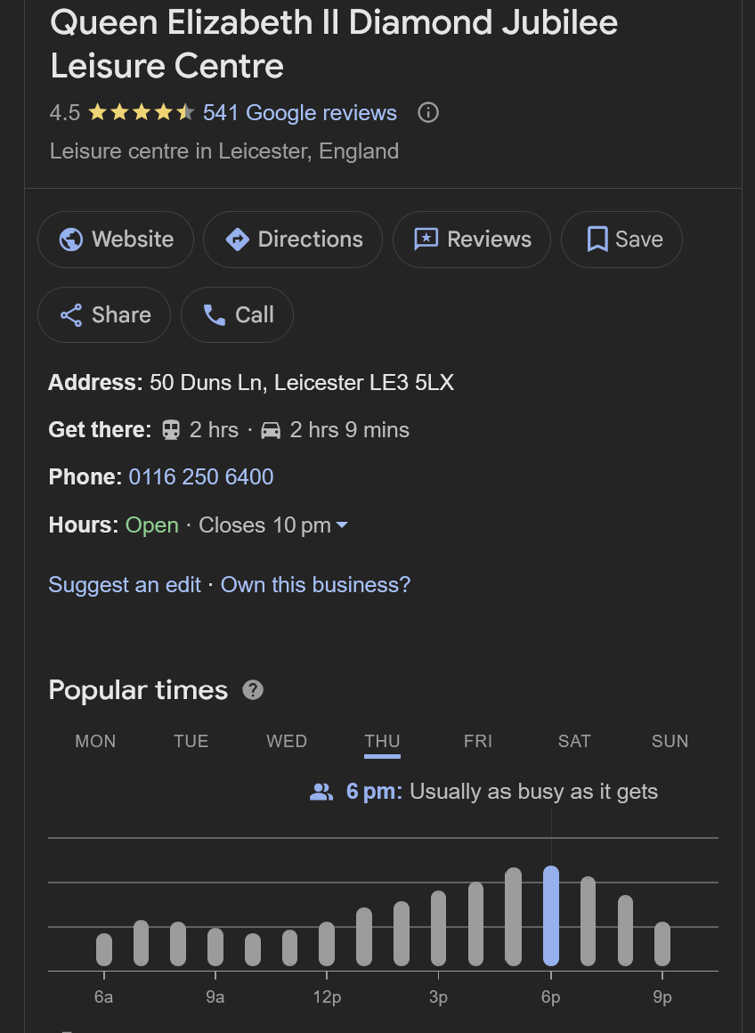
Pattern of Life Analysis
Pattern of Life is the identification of normal behaviour over time based on analysis of activity or lack thereof.
Time – when activity occurs
Place – where activity occurs
Routine – what repeats
®

Slide 10










GEOINT
GEOINT is the exploitation of location-based data to infer behaviour, capability and intent.
Satellite Imagery
GPS & Location Tracking
Maps, terrain & infrastructure data
Geospatial metadata
Temporal Analysis
®

Slide 11
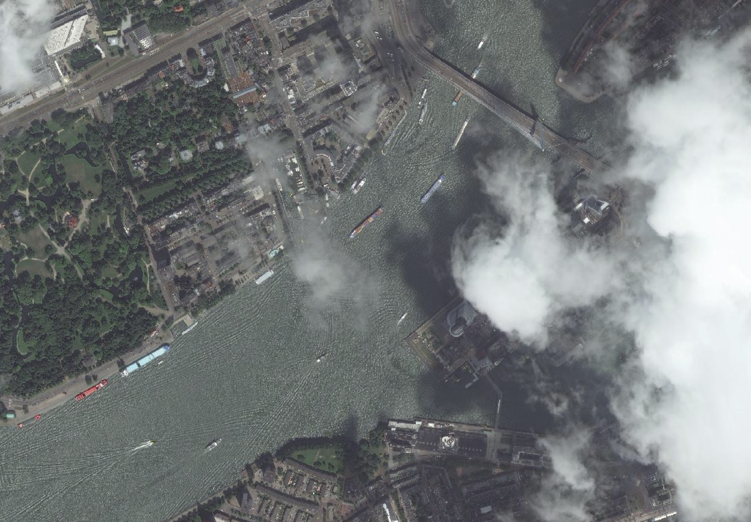
®

Slide 12
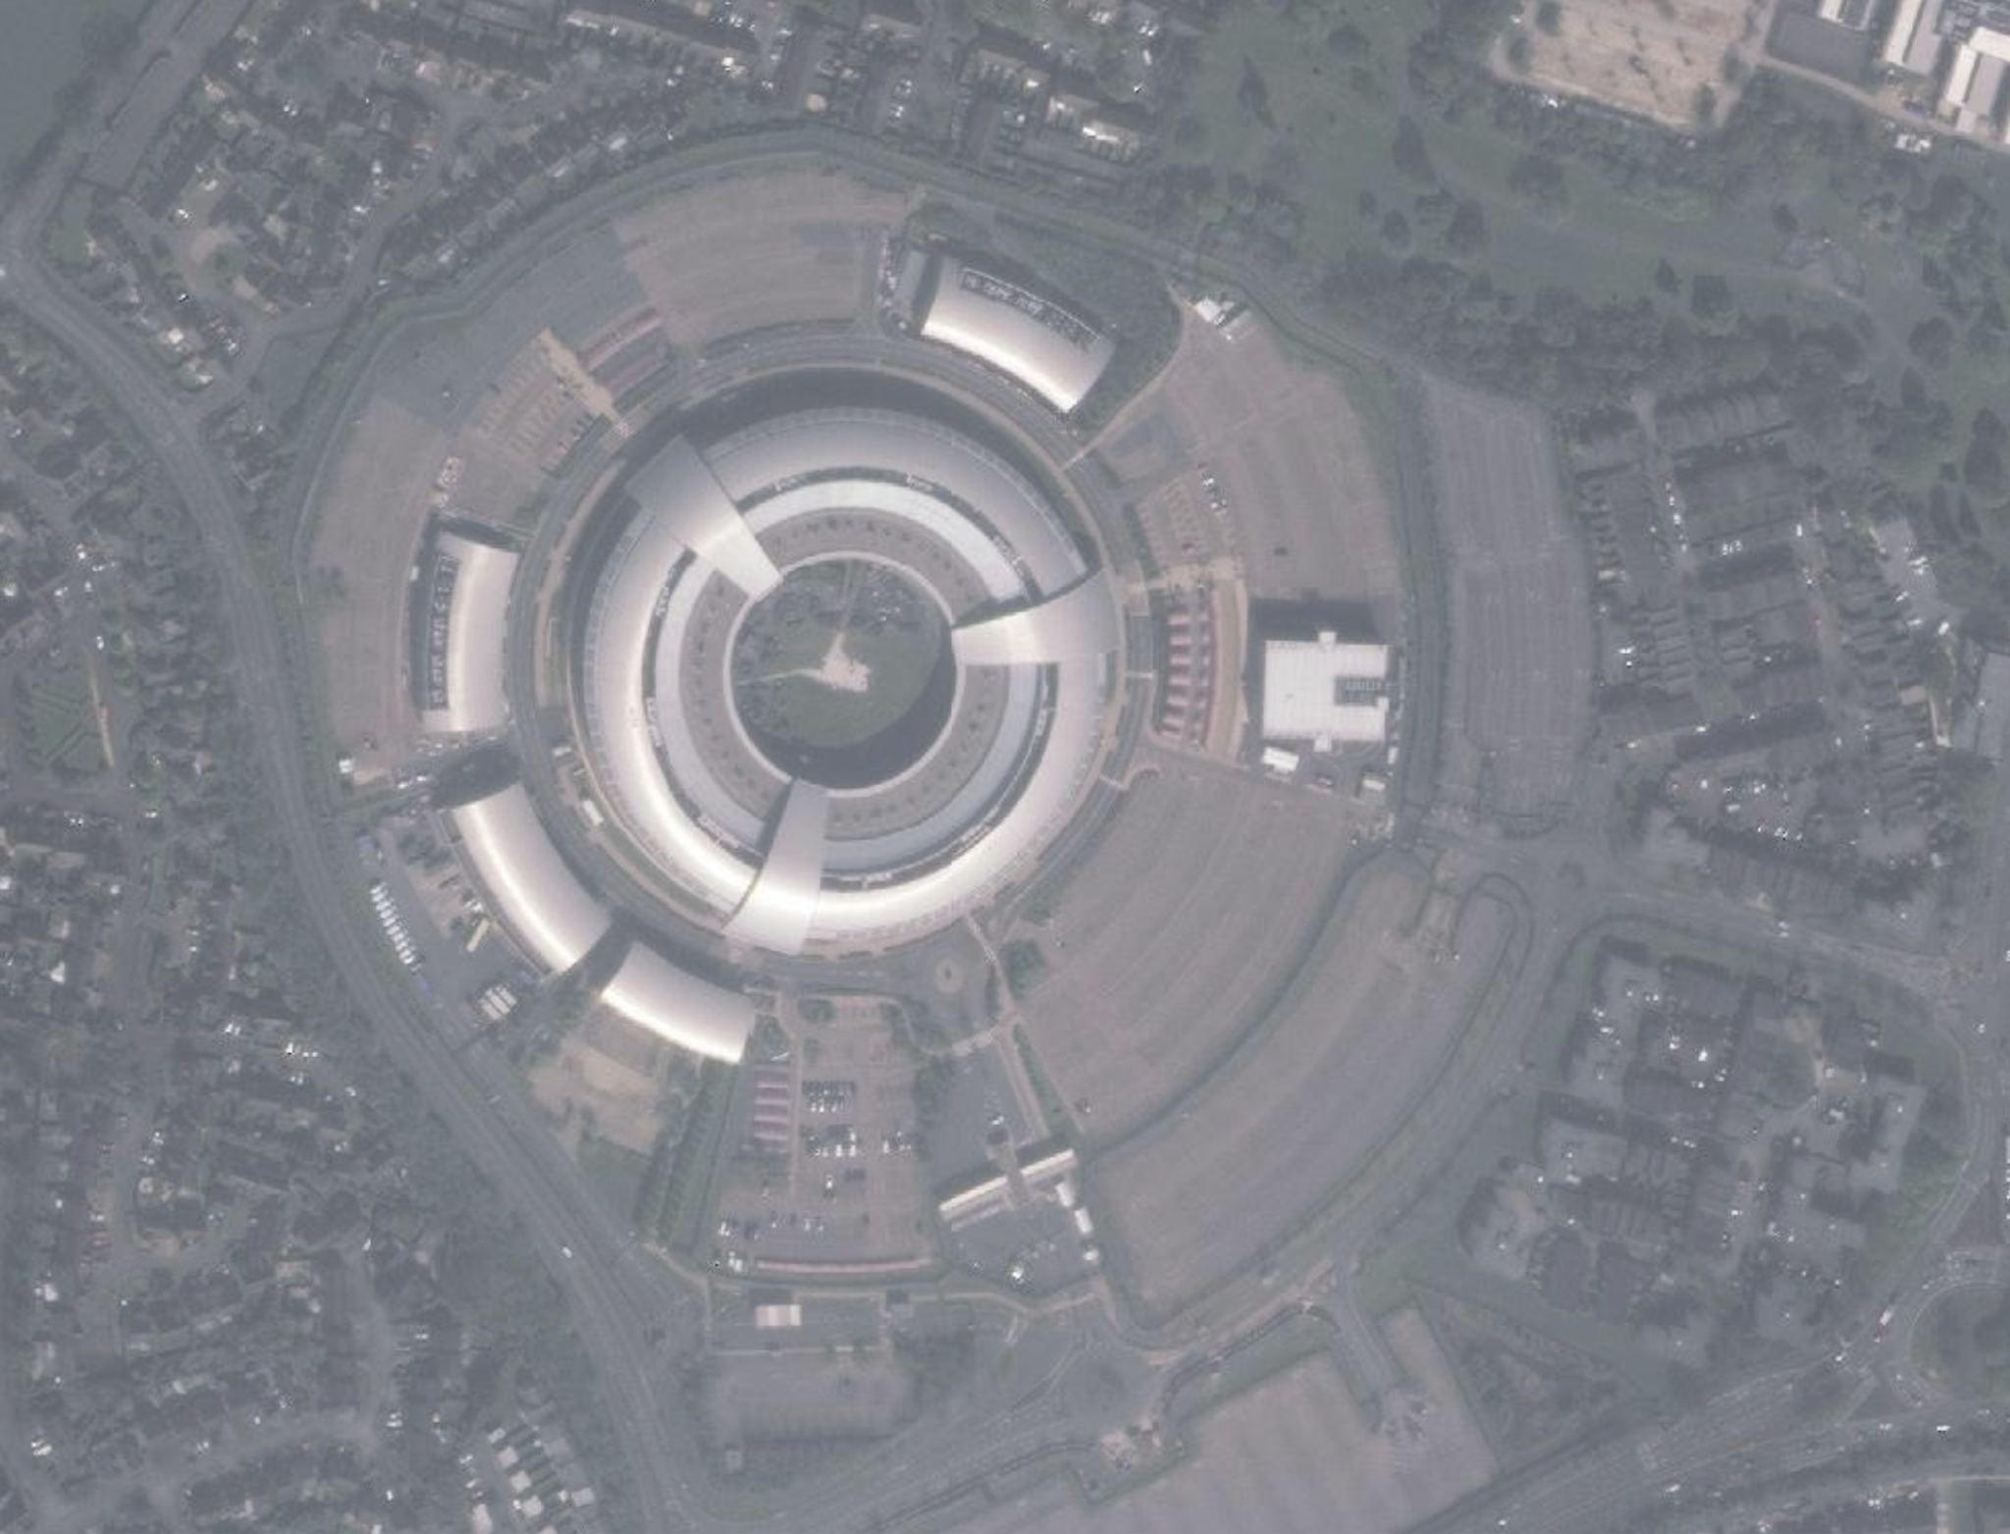
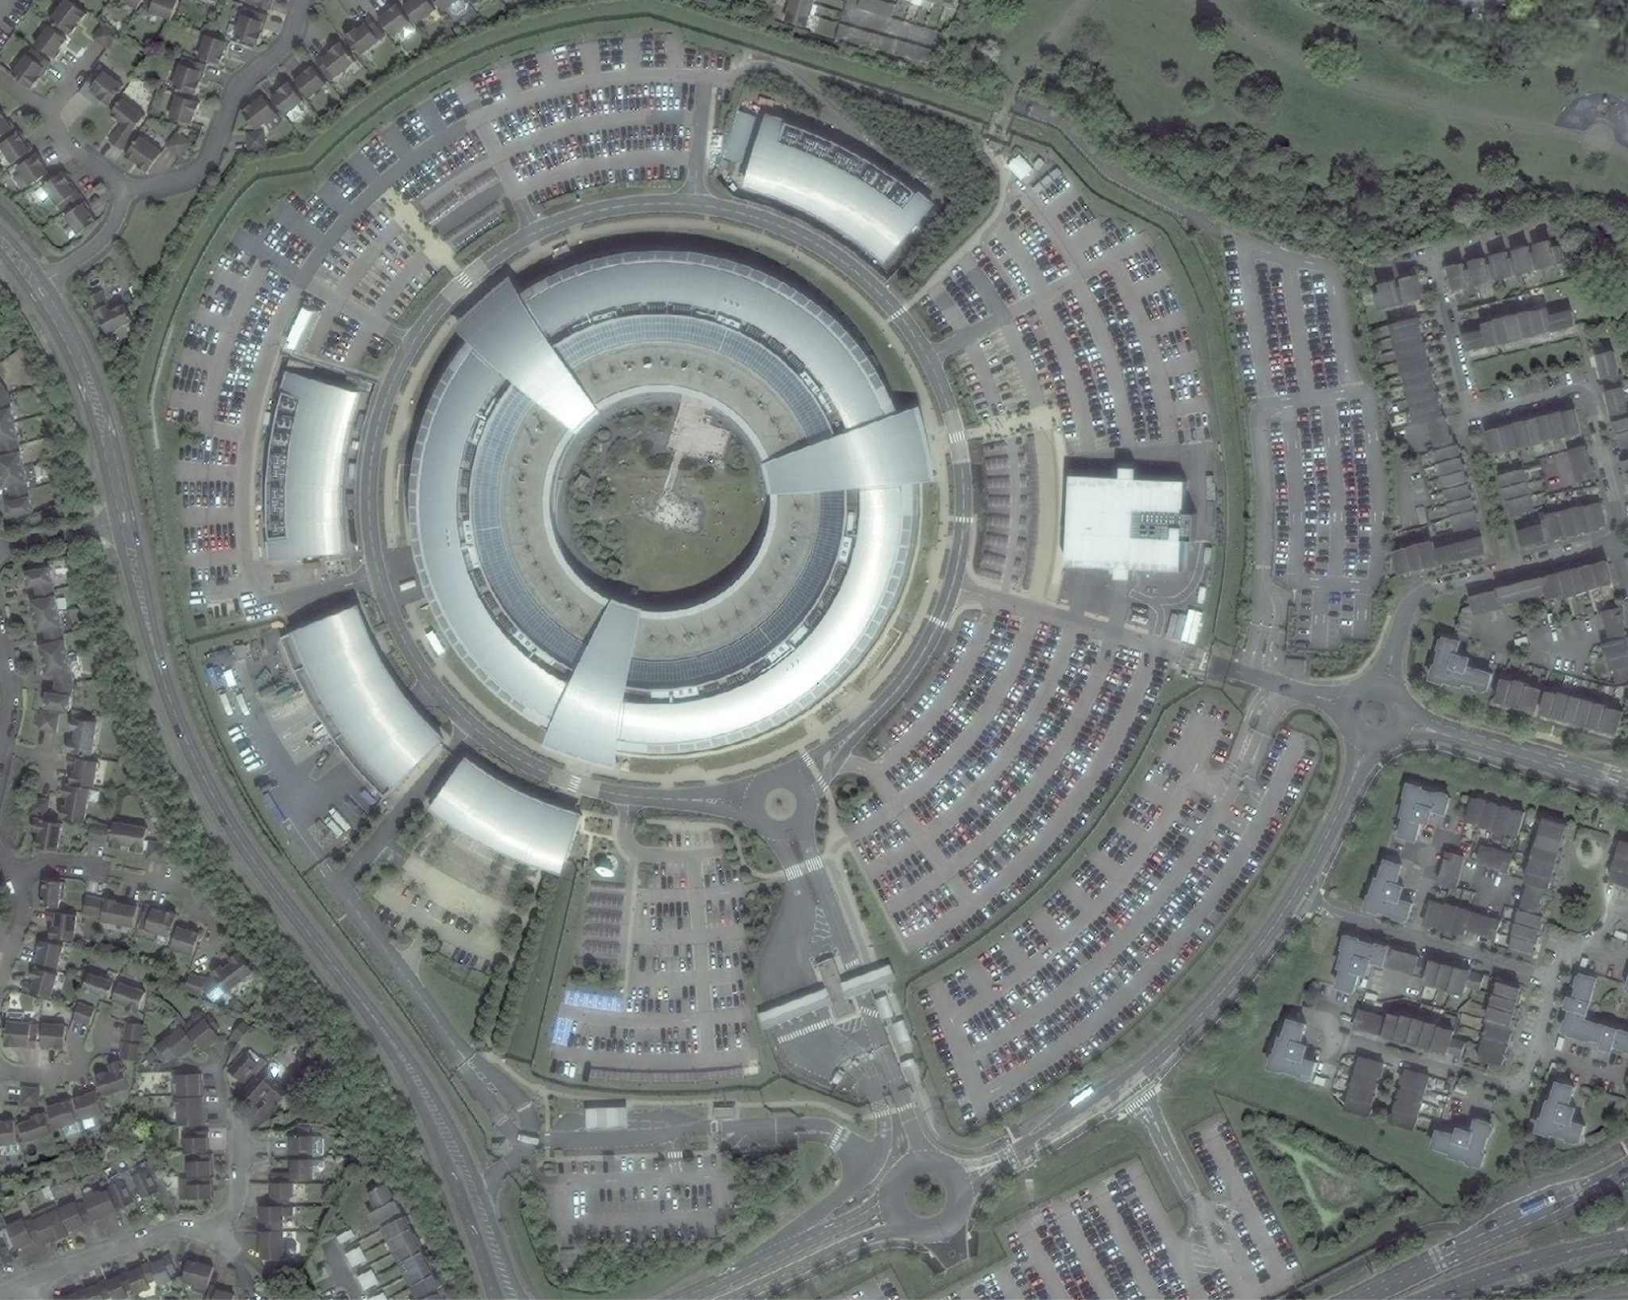
Turning visuals into intelligence: what's the difference here?

Slide 13



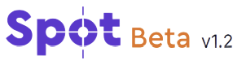



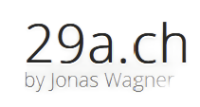




IMINT
IMINT analyses imagery to determine origin, context, authenticity, and meaning. This is a growing field in the age of AI as verification becomes required across broader contexts such as SOCMINT and News.
Observation: identifiable architecture & signage
Correlation: same image appears in earlier posts
Assessment: image reused / misattributed
Implication: narrative manipulation / OPSEC failure
Techniques:
Image provenance analysis
Context recovery (where else has this image appeared?
Visual landmark matching
Temporal verification (when was this image first seen?)
Manipulation & reuse detection
®

Slide 14

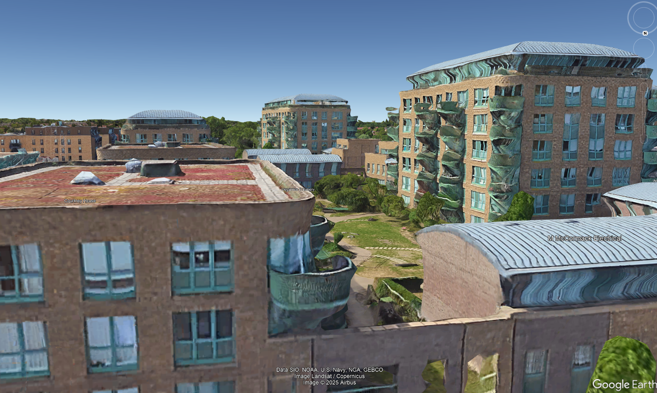

Slide 15

























CYBINT
CYBINT is extracting intelligence from internet infrastructure and cyber telemetry to assess exposure, threats, and intent.
Domains & DNS (ownership, misconfig, lookalikes)
IP space & hosting (infrastructure, regions, providers)
Certificates (CT logs, related services)
Breach/stealer telemetry (credential exposure, session tokens)
Malware / threat intel signals (IOCs, TTPs, actor infrastructure)
Use Cases
Attack Surface Mapping
Brand/Identity Misuse (Typosquatting, Phishing inf, Exec imp)
Credential Exposure (Users, Pwds, Session Tokens and on..)
Linkage of cyber attack inf to real world identities or locations
®

Slide 16
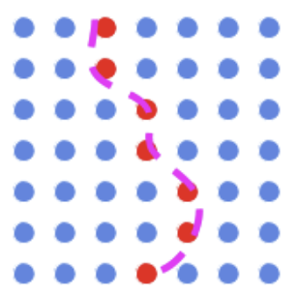
ADINT
ADINT exploits online advertising systems and derivative data to infer interests, behaviours and identities.
AD Platforms
Tracking Pixels & Cookies
Device & Browser Fingerprints
Location & Interest Segmentation
ADINT can be used both for positive and negative forces. Investigators can use tracking pixels or advertising IDs from served malicious advertisements to link infrastructure and track the responsible party.
Actors can be misused for covert profiling, such as tracking device location based on which location-based ADs they interact with, or querying their MAID ID to see what ADs they have interacted with.
What can be done with a MAID? “This varies a lot depending on the situation. For example, if one knew that their neighbor lived alone, they could target their IP address or house’s location with ads and use that as a stand-in for the MAID. Doing this, one could find out information like whether they use specific dating or religious apps.” MAIDs can also be queried within a geographic area.
Settings -> Privacy & Security -> Tracking -> OFF
Settings -> Privacy & Security -> Location Services
Apple Advertising -> Personalised ADs -> OFF
https://adint.cs.washington.edu/
https://medium.com/@thecyberhuntress/what-is-adint-advertising-intelligence-and-how-is-it-used-in-cybersecurity-e7a2de0bb34c
®
Notes:
Minor: One link hyperlinked (blue), the other not

Slide 17























SOCMINT
(Douban) (Rednote)
SOCMINT analyses social media content and online communities to infer behaviour, relationships and intent.
Public Social Media Content
Forums, chat platforms & community spaces
User interactions
Network Relationships & Associations
Temporal Posting Patterns
Use Cases
Pattern of Life Analysis (Timezone, Posting Routine, Frequent Locations/Activities)
Identity & Account Correlation (Cross-platform, username correlation)
Narrative & Influence Analysis
Risk & Escalation indicators (Tone, frequency, threat language)
®

Slide 18
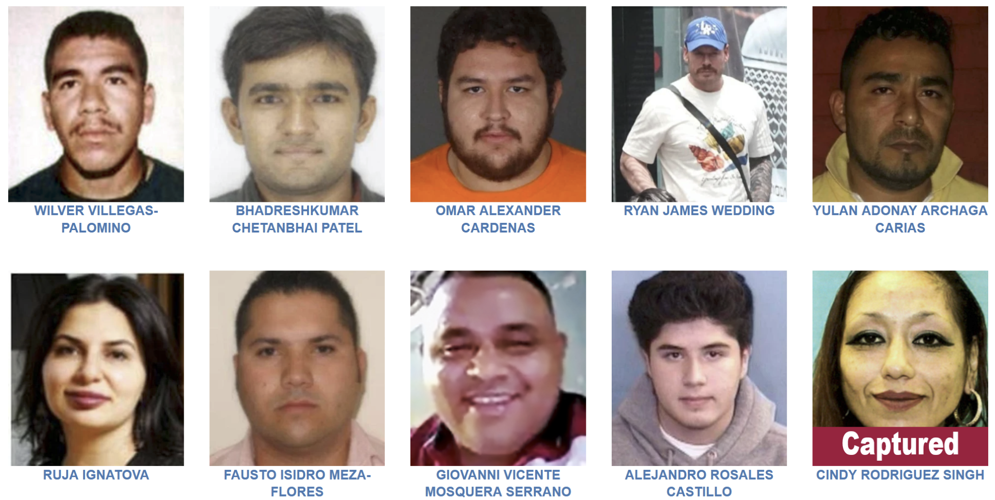

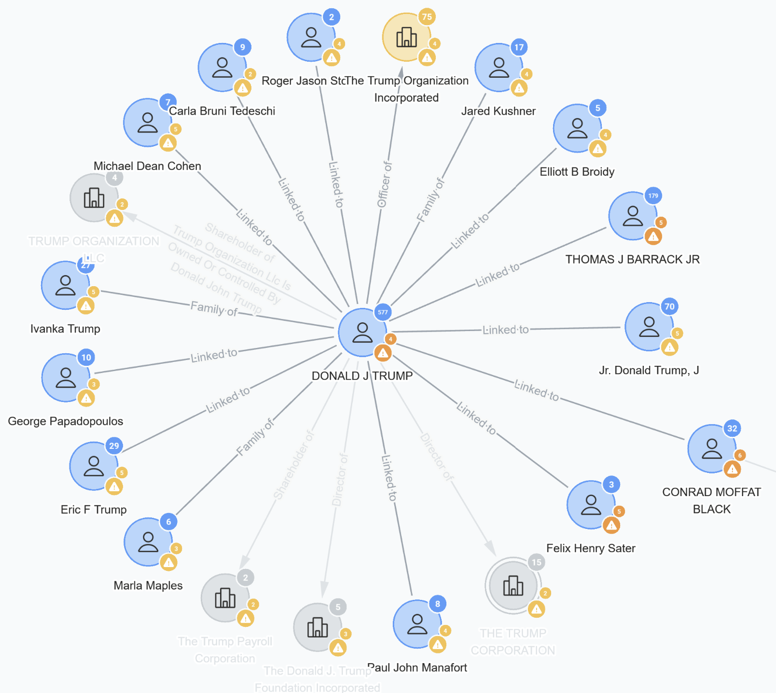
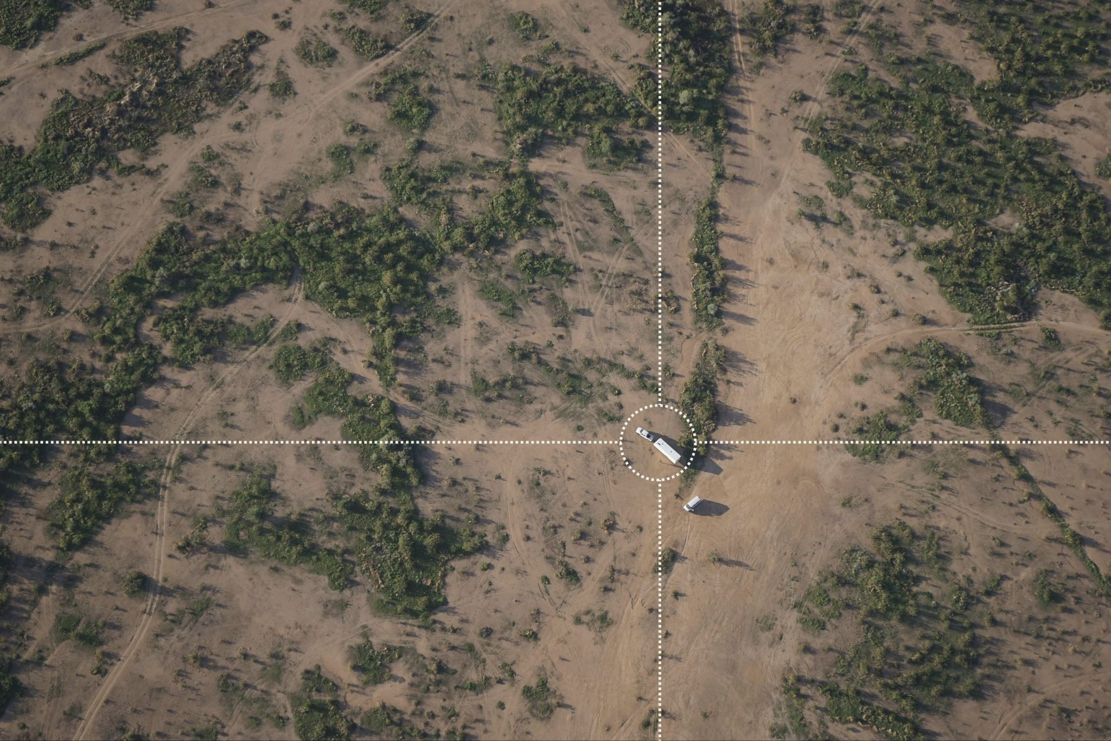

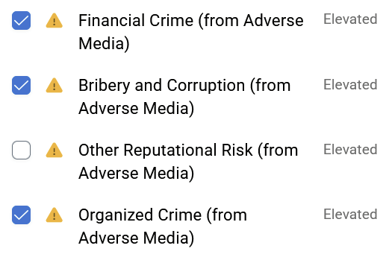
Use Cases
®

Slide 19
Careers
Cyber Threat Intelligence
Journalism
Law Enforcement / Military Analyst
Counter Terror
All cyber roles use a little OSINT….
Risk & Compliance
Human Rights Research
Red Teaming
Due Diligence/Corporate
Security Analyst
Policy Advisor
Background Checking
Import/Export Investigations
Intelligence Analyst
Financial / AML Investigator
Legal Researcher
Geopolitical Risk Analyst
Maritime/Aviation
ThinkTank/NGOs
Private Investigations
Disinformation / Reputation Management
Open Source Intelligence Analyst!!!
Junior OSINT Analyst @
®

Slide 20


Practical

Slide 21
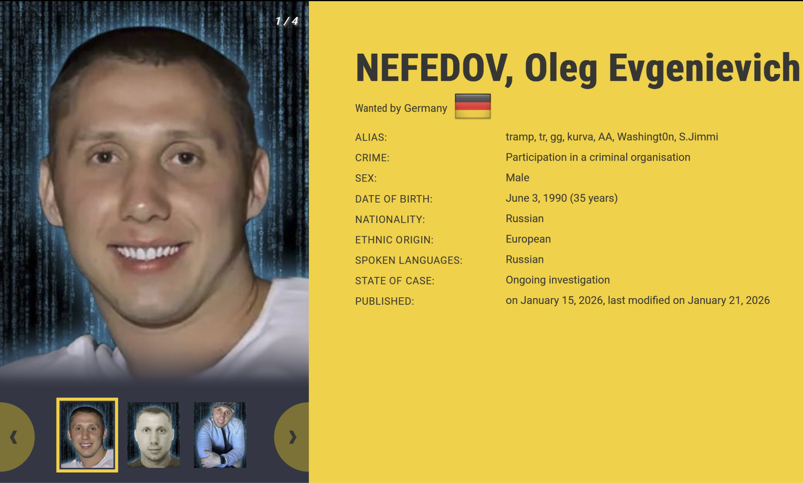
Practical

Slide 22
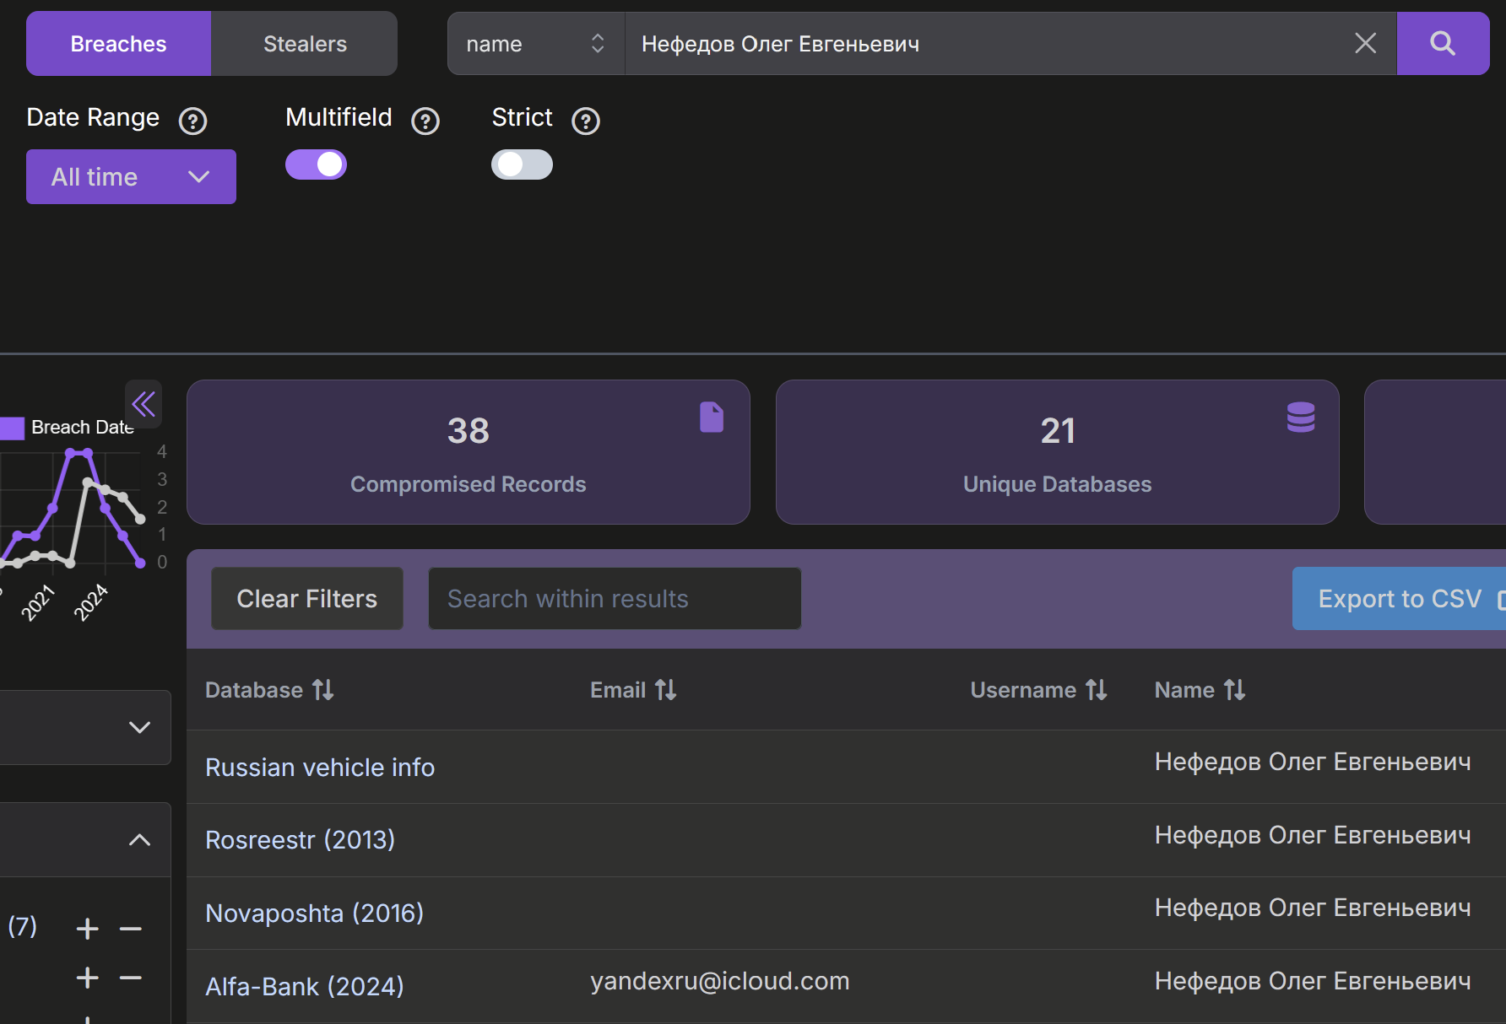
Practical

Slide 23
Practical
yandexru@icloud.com
Where has this email been registered?
Use any free/available tools discussed today

Slide 24
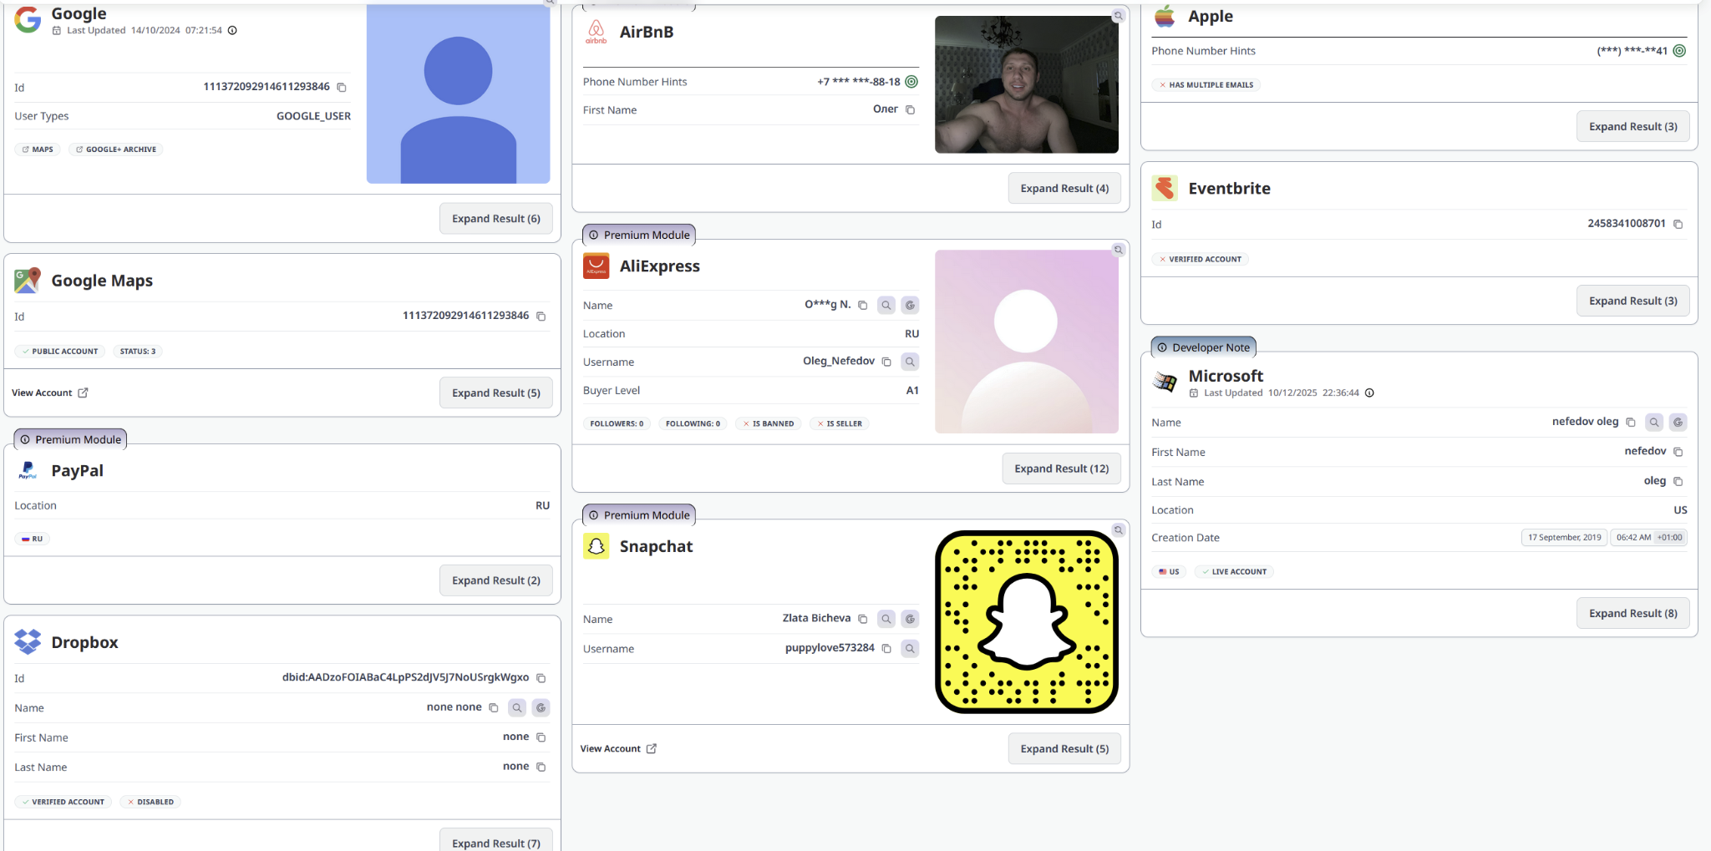
Practical
yandexru@icloud.com
Where has this email been registered?
Use any free/available tools discussed today

Slide 25
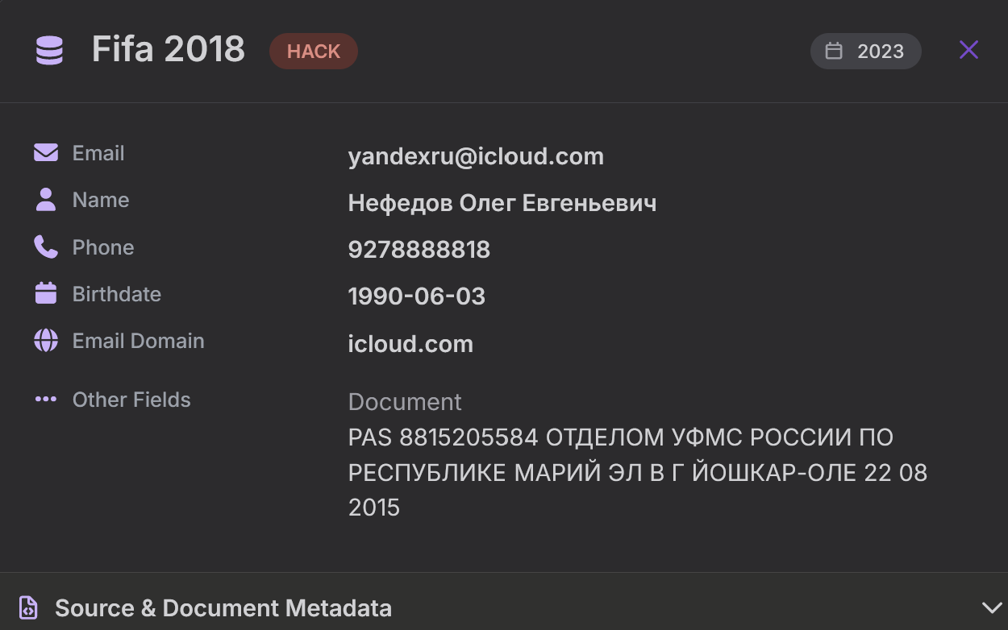
Practical
9104427451
Run this through phone number lookup services

Slide 26
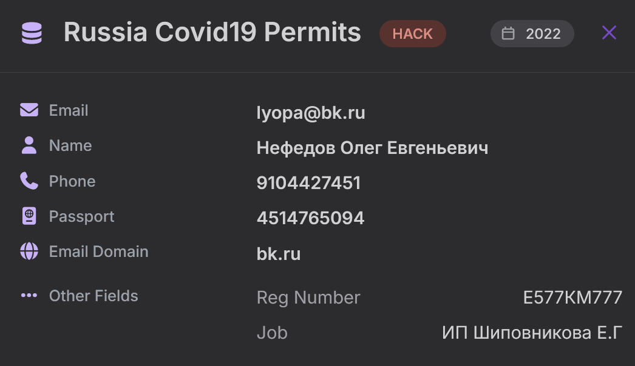
Practical
9104427451
Run this through phone number lookup services

Slide 27
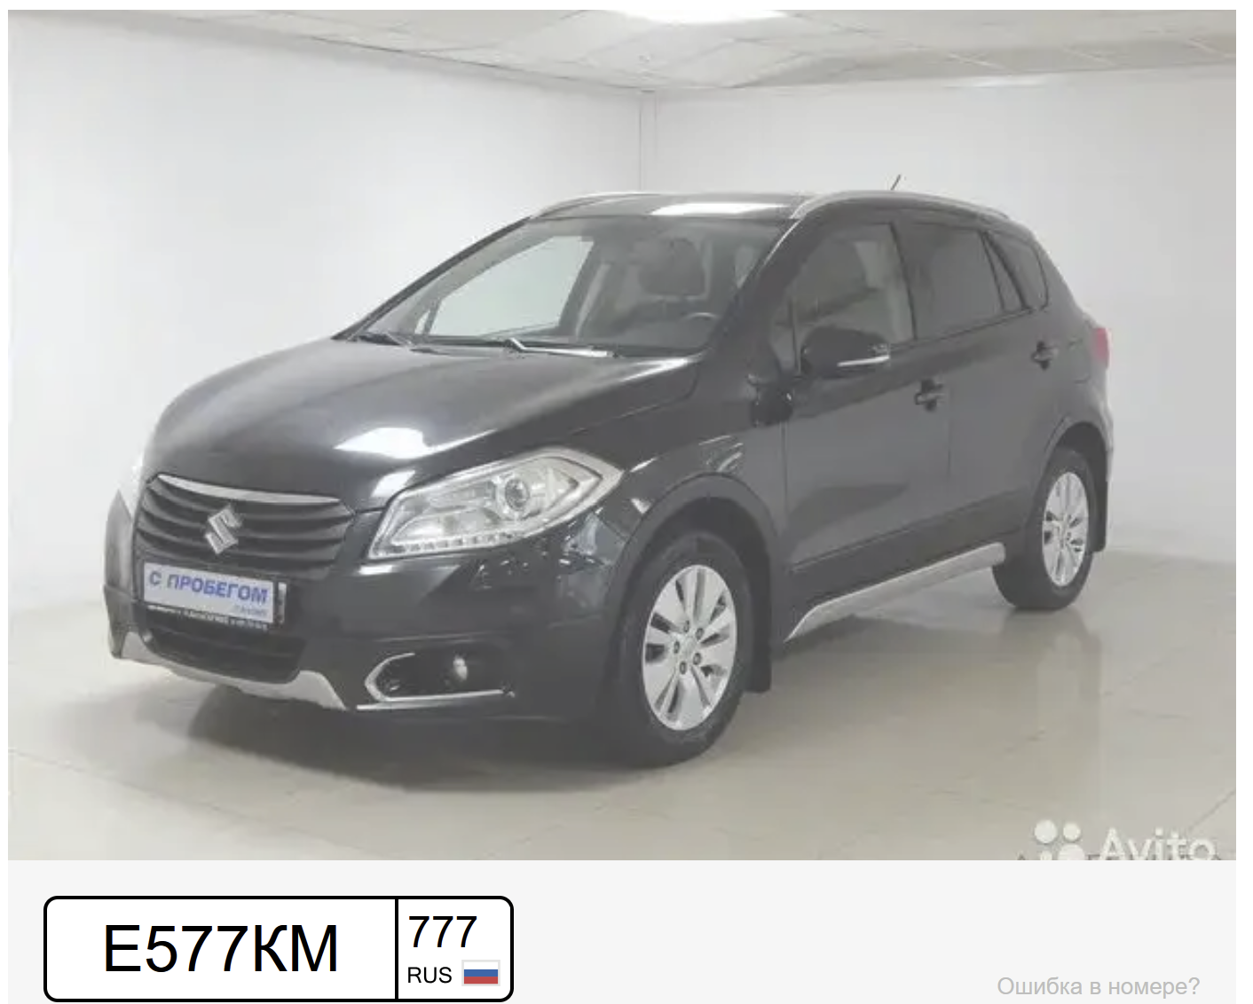
Practical
9104427451
Run this through phone number lookup services

Slide 28
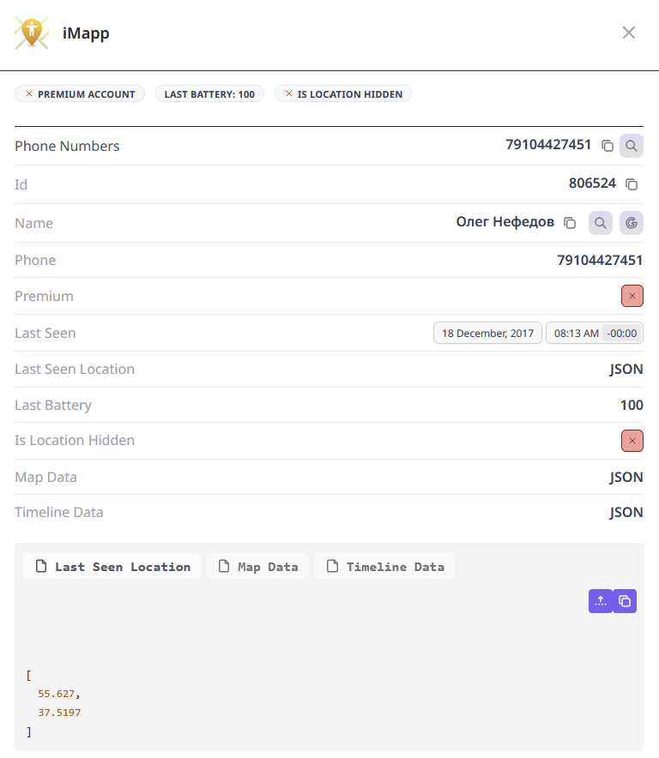
55.627
37.5197

Slide 29
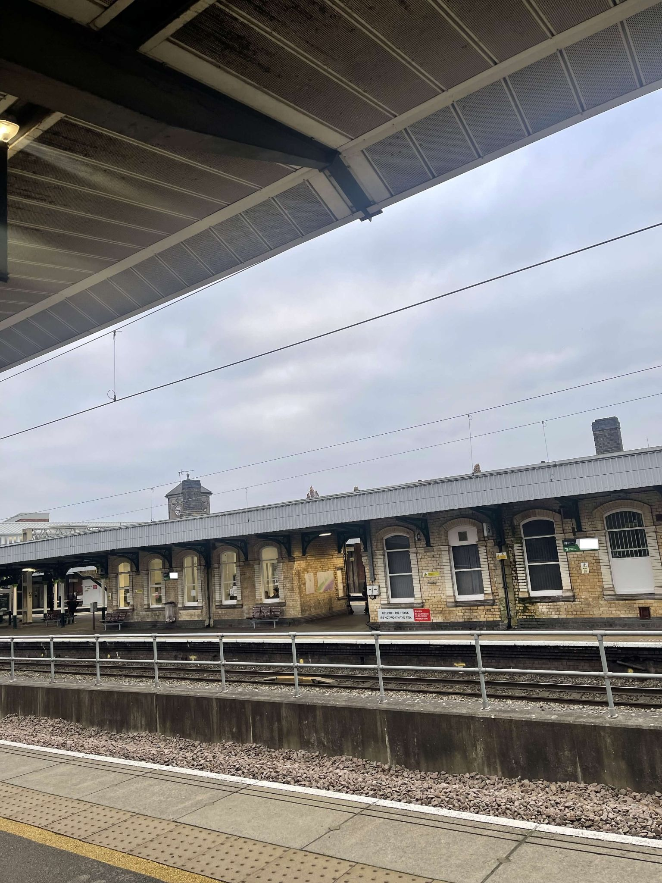
https://tinyurl.com/nqh-geo

